Slide 1
Dependency Management for C++ Applications using CMake + Conan
Kunal Sharma
Software Engineer at Infineon Technologies

Slide 2
Quick Recap

Slide 3
What can you expect?
Write a CMake file
Install/Consume CMake packages
Write a Conan file
Create/Fetch Conan packages
Utilize open source efficiently

Slide 4









Need for Dependency Management
Dependency Management
Present
Future
Lib A
Lib A

Slide 5
Quick Questions
What is Dependency Management?
Dependency management is a technique for declaring, resolving and using dependencies required by the project in an automated fashion.
What is a Package Manager?
A package manager or package-management system is a collection of software tools that automates the process of installing, upgrading, configuring, and removing computer programs for a computer's operating system in a consistent manner.
What is a Build System?
A build system allows you to transform your project assets into a final usable product that can be consumed by a consumer.

Slide 6
Highlights from CMake
Build System Generator
Producing binaries (libs, exe)
Running unit tests with CTest
Creating/Consuming packages
Install/Export
find_package
Handling transitive dependencies
find_dependency

Slide 7
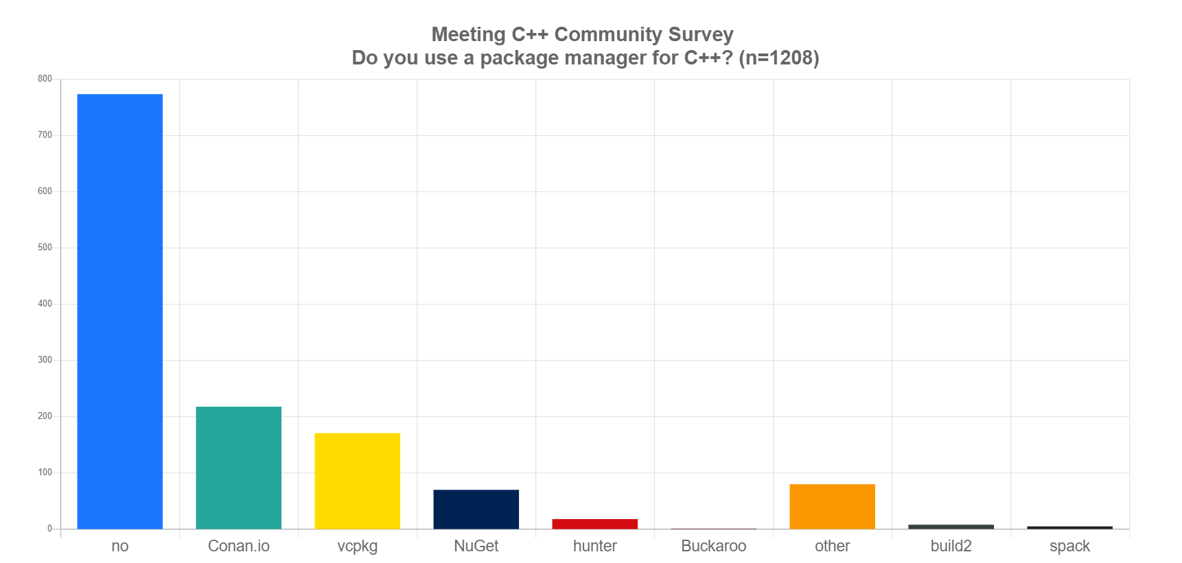
Better way of Distribution?
A package manager or package-management system is a collection of software tools that automates the process of installing, upgrading, configuring, and removing computer programs for a computer's operating system in a consistent manner.

Slide 8
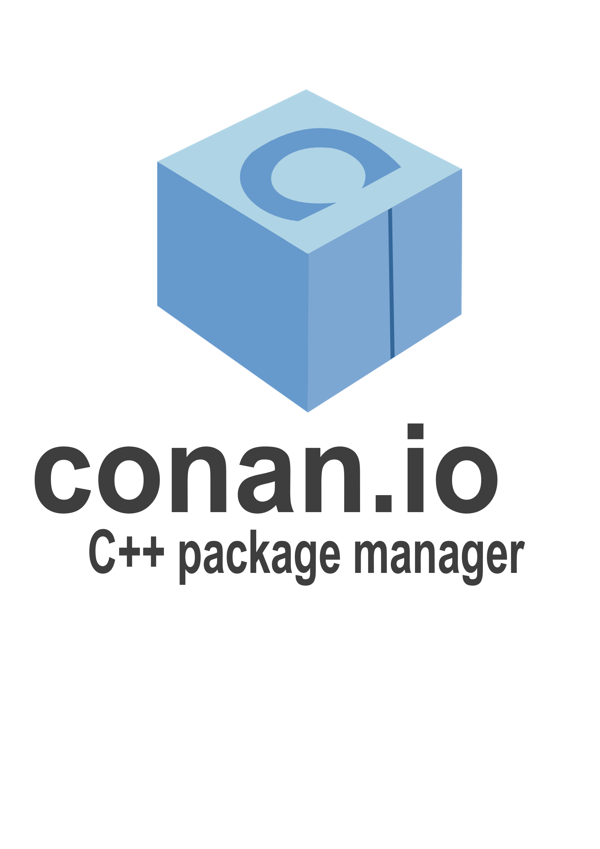


An Ideal Package Manager
Open Source
Artifactory
Artifactory
Lib X
Lib A
Lib Y
Lib B
Lib Z
Lib C
Lib n
Lib n
Dependency
Description
Lib

Slide 9
Conan
Decentralized package manager with client – server architecture
OSS, Corporate, Private, etc.
Located Cache
allows sharing of dependencies among multiple projects
Supports:
sources only
sources + binaries
binaries only
Offline use
Free available trainings!!!
https://blog.conan.io/2020/09/24/New-conan-training-series.html

Slide 10
Conan
Simple to write Conan files
Python
Works with a wide pool of build systems
Platform independent
Multiple packages with same name can exist
they are unique since their configs are different
JFROG supports Conan Artifactories
easy to set up and elegant UI
Great community and contributors
packages being updated in no time

Slide 11
How to use Conan?
Conan follows a package naming convention:
package_name/package_version@user/channel
Use this naming info in your Conan files(recipes):
conanfile.txt
conanfile.py
For fetching the packages from the artifactory:
conan install path_to_your_conanfile
Generate conanfile.py template using:
conan new package_name/package_version
To search for a package in a remote:
conan search package_name/package_version –r conan_remote
By default, the open source remote is conan-center

Slide 12
Conanfile Attributes
settings
Compiler, OS, architecture, etc.
options
Shared, custom options, etc.
requires
represents package dependencies
generators
Provide information about dependencies that is understandable to the build system
Not needed if your package doesn’t have a dependency
Methods to manage packaging flow
source(), build(), package(), package_info(), etc.
“option”: [“value1”, “value2”]

Slide 13
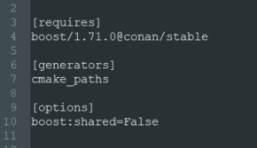
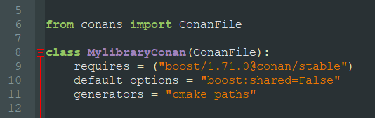
Consume a Conan Package
CMAKE_TOOLCHAIN_FILE
Provide information to our build system about packages fetched Conan
conanfile.txt
conanfile.py

Slide 14
Conan Profiles
Mentioning all these configurations in a conanfile or in the command line is too much of a repetitive task
Profiles
Specify all the configurations like settings, options, environment variables,
etc. in a single file
Profiles
GCC
Clang
MSVC
x86
x64
x86
x64
x86
x64

Slide 15
Conan Package Creation and Upload
To create a package:
conan create path_to_conan_recipe user/channel
To list remotes:
conan remote list
To add a remote:
Conan remote add remote_name
To upload a package:
conan upload package_name/package_version@user/channel --all

Slide 16
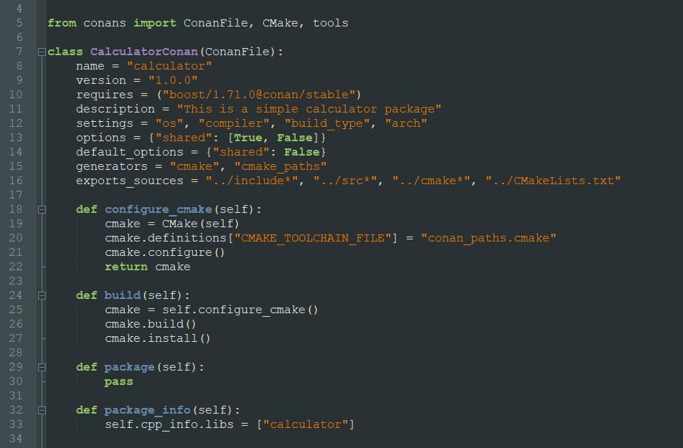
conanfile.py

Slide 17
Handling Transitive Dependency
Dependency
Handles transitive dependencies effortlessly

Slide 18
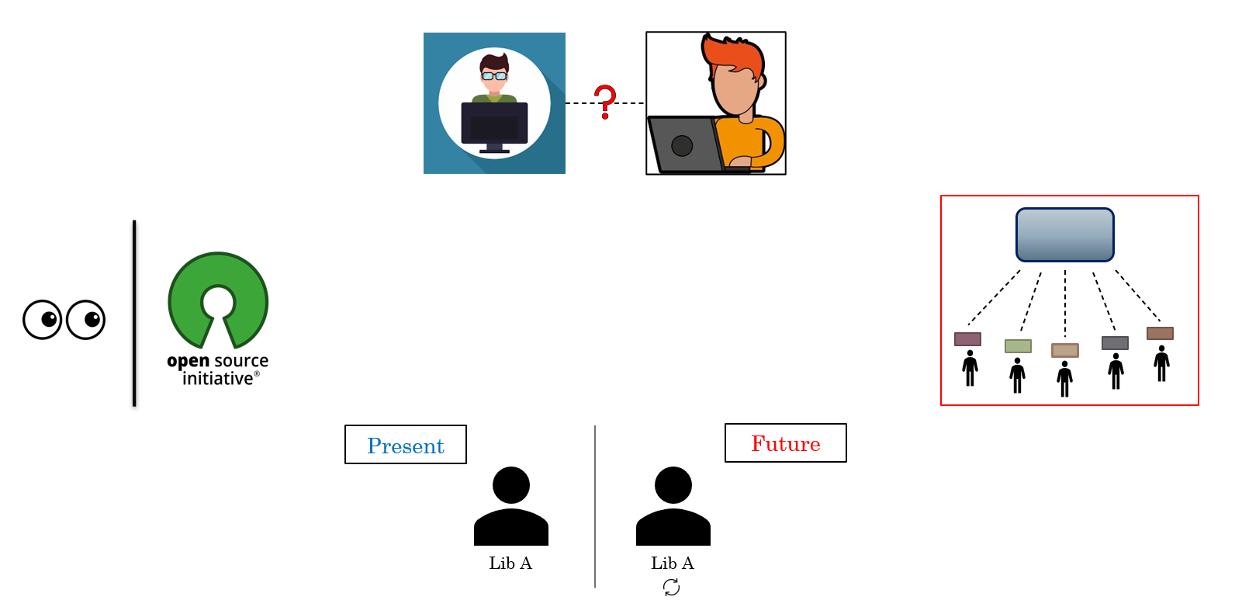


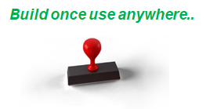
Final Picture
CMake

Slide 19

References
Conan: https://conan.io/
Conan trainings: https://blog.conan.io/2020/09/24/New-conan-training-series.html
Git, CMake, Conan at CppCon: https://www.youtube.com/watch?v=S4QSKLXdTtA
Connect with me: https://in.linkedin.com/in/kunalsharmaaa
THANK YOU

